Slide 1

Memory Design and Testing (PVL 331)
Dr. Rajneesh Sharma
Assistant Professor
Thapar Institute of Engineering & Technology, Patiala

Slide 2
Module 1
Basics of Semiconductor Memory
Internal Organization of Memory Chips
SRAM Cell
DRAM Cell
Ferroelectric Memory
Flash Memory Cell

Slide 3
Internal Organization of Memory
Memory Cell Array
Peripheral Circuit
Input/Output Interface Circuit
Fig. 5 Memory Chip Configuration

Slide 4
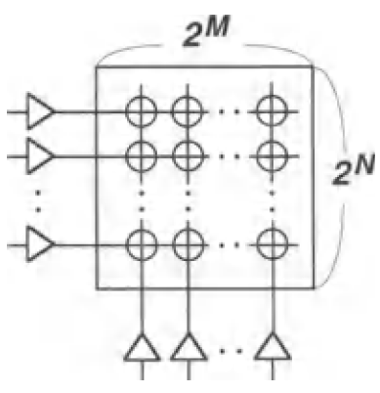
Internal Organization of Memory
Memory Cell Array
A memory cell array comprising a matrix of 2^{N} rows and 2^{M} columns can store binary information of 2^{N +M} bits.
e.g. if N + M = 20, a memory chip can store 1 Mbit of information.
It can have 1D, 2D or 3D structure
Fig. 4 Memory Cell arrangement (a) 1D (b) 2D.
Notes:
Sometimes, the memory cell array is called memory cell matrix, a memory array, or simply an array. The memory cell array can be of 1 Dim, 2Dim or 3 Dim arrangement. Memory cell arrangement for 1D and 2D is shown in Fig. 4. In the 2D memory array, The row is also called the X line or word line, while the column is called the Y line, bit line, or data line. Remember this nomenclature because we are going to use it very frequently. Here, matrix arrangement helps to minimizes the number of driving circuits for given memory cells: the number is calculated as (2^{N} + 2^{M} ) for 2-dimensional arrangement , and you know this no would be min when N= M. While it is 2^{N+M} for 1-Dimensional array. So you can see that 2Dim array is used to reduce the no of driver circuit e.g. 1Mbit of memory require only about 2000 circuit in 2D array as compared to 1Million circuit for 1D array.
Here M denotes 1024 K, with K = 1024. If N + M = 30, we call it a 1 Gbit (1 G or 1 Gb) memory chip, with G = 1024 M.

Slide 5
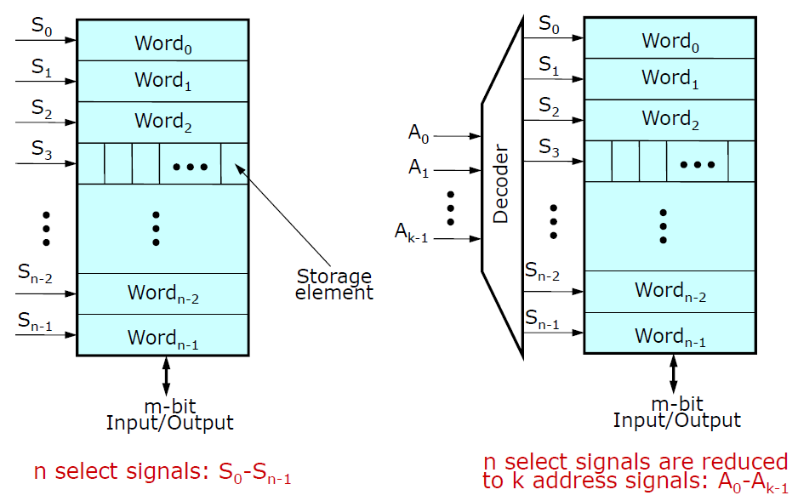
Internal Organization of Memory
1D Structure
Notes:
Here we can see the detailed view of 1D array. The signals S0, S1, S2 are the select signals coming from the driver circuit. No. of select signal depends upon the no. of words stored in the memory array. However, we can reduce these select signals using the decoder circuit. Simple binary decoder only require log₂(n) select signals instead of n select signals to assess the n words.
1D array is very simple to use, however, it is not suitable for large memory.

Slide 6
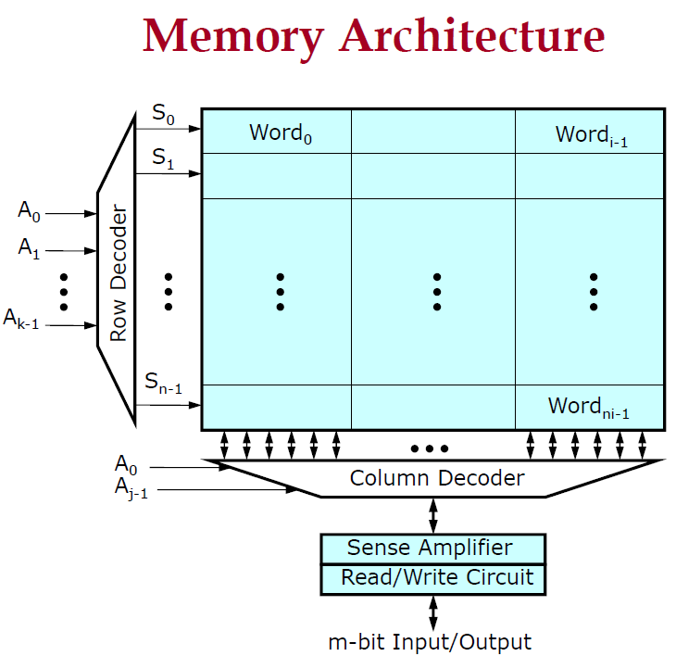
Internal Organization of Memory
The row is also called the X line or word line, while the column is called the Y line, bit line or data line.
2^{N} words of 2^{M} bits each.
Notes:
For larger memory, we use 2 D array. You can see separate decoder circuits for Row and Column in 2D arrangement. The column circuitry may contain amplifiers or buffers to sense the data.
The row decoder uses the address to activate one of the rows by asserting the wordline. A typical memory array may have millions of words where each word contain only 8 to 64 bits. This would lead to a tall, skinny layout that is hard to fit in the chip floorplan and slow because of the long vertical wires. Therefore, the array is often folded into fewer rows of more columns.
As we have discussed in previous slide that for minimum no of signal require N = M i.e. no. of word = no. of bits in each word. This condition can not be achieved as we do not have word length beyond 64 bits.

Slide 7
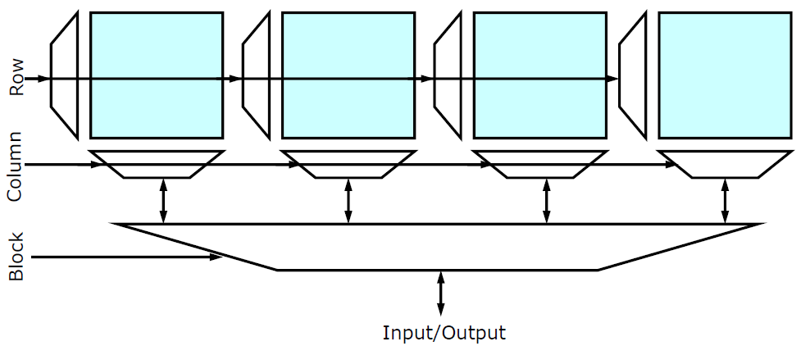
Internal Organization of Memory
Fig. 6 Hierarchical Memory architecture
Advantages:
Shorter wires within blocks
Block address activates only 1 block => power savings
Notes:
Next is Hierarchical Memory architecture. This architecture is used where more computational or memory is required e.g. RAM. If you have seen RAM of your PCs, You can easily corelate this architecture with the RAM chip. This architecture have advantages like (read 1 and 2). However, we can not keep on increasing the memory blocks as it reduces the overall speed of the memory.

Slide 8
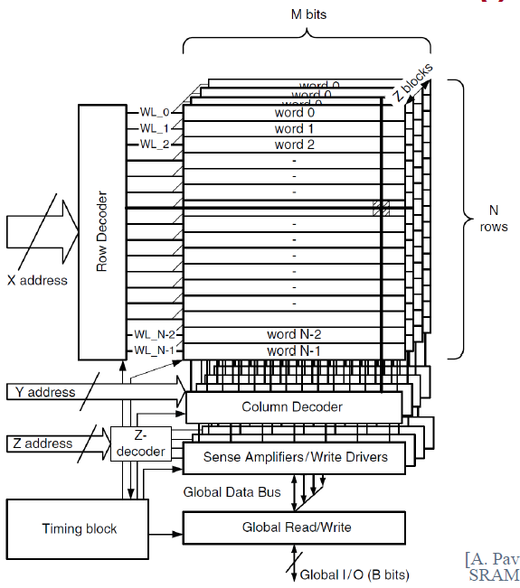
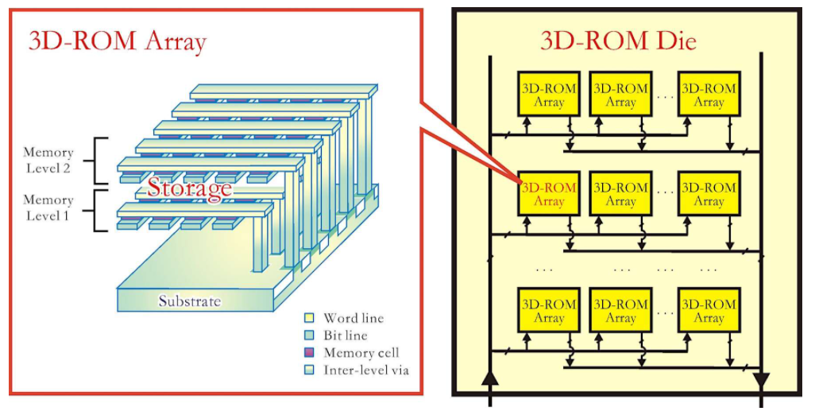
Internal Organization of Memory
Fig. 7 (a) SRAM (b) 3D ROM Array [Source: https://www.edn.com/3d-computational-architectures-and-applications/]
Notes:
We can also design RAM and ROM as a 3 dimensional array.
In 3D SRAM memory array, Rows and columns are stacked on each other with depth of Z. In this case I/O interface circuit and peripheral circuit become more complicated.
In the Figure 7.b 3D ROM array is shown. Here, memory cells form memory levels 1 and 2 which are then stacked on top of each other. Within each memory level, address lines form a cross-point array and the memory cells are located at their intersections. If it has a low resistance, the memory cell represents '1'; otherwise it represents '0'. The bottom of the 3D-ROM die is known as substrate and it contains transistor circuits for reading/programming the memory cells. The first 3D-ROM product was a 3D-OTP (one-time-programmable) developed by Matrix Semiconductor. In 2005, Matrix released a 1Gb 3D-OTP at the 130nm node. Recently, In 2017, Intel released a 128Gb 3D-ROM at the 20-nanometer (nm) node. You can find many patents on 3D memory in the recent time.

Slide 9
Internal Organization of Memory
Memory Cell Array
Peripheral Circuit
Input/Output Interface Circuit

Slide 10
Internal Organization of Memory
Peripheral Circuit
It write data to a memory cell in the memory array under the control of the interface circuit or read data from the memory cell to the interface circuit.
Here Row and Column decoder circuit is a peripheral circuit. It select a corresponding row and column after reading the values N and M from the address buffer or I/O interface.
Notes:
The block bridges between the memory array and the r/o interface circuit so that they can communicate with each other. It sends write data to a memory cell in the memory array under the control of the interface circuit, or sends read data from the memory cell to the interface circuit. A typical circuit here is a decoder, which is composed of many logic circuits. It selects a logic circuit corresponding to one row or one column, based on a logical set of N or M address signals from address buffers in the interface circuit. Then, a row or column is driven by a driver, which is connected to the output of the logic circuit. Here, an i/o control circuit in the figure controls the transfer of the write or read data in the memory array.
Sense amplifier

Slide 11
Internal Organization of Memory
I/O Interface Circuit
This converts external signals, such as addresses, docks, control signals, and data inputs, to the corresponding internal signals that activate the peripheral circuit.
Notes:
This converts external signals, such as addresses, docks, control signals, and data inputs, to the corresponding internal signals that activate the peripheral circuit. In addition, it outputs read data from the array as the data output of the chip. Address buffers in the 1/0 interface circuit generate N and M sets of complementary row and column address signals respectively. Data input and output buffers, a write control buffer, and control dock circuits are also typical components of the 1/0 interface circuit. Note that, in general, ROM does not need data input buffers.

Slide 12
Internal Organization of Memory
Notes:
This converts external signals, such as addresses, docks, control signals, and data inputs, to the corresponding internal signals that activate the peripheral circuit. In addition, it outputs read data from the array as the data output of the chip. Address buffers in the 1/0 interface circuit generate N and M sets of complementary row and column address signals respectively. Data input and output buffers, a write control buffer, and control dock circuits are also typical components of the 1/0 interface circuit. Note that, in general, ROM does not need data input buffers.

